Slide 1

K. Praveen Kumar
Asst. Professor
GITAM University

Slide 2
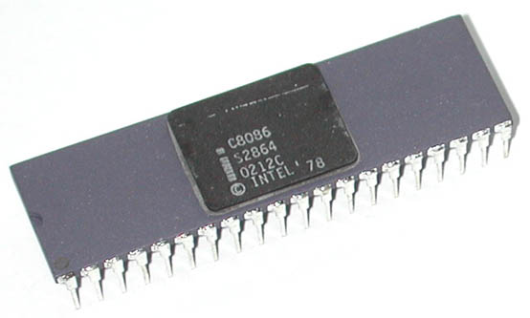
Intel 8086
Intel 8086 was launched in 1978.
It was the first 16-bit microprocessor.
This microprocessor had major improvement over the execution speed of 8085.
It is available as 40-pin Dual-Inline-Package (DIP).

Slide 3
Intel 8086
It has a 16 line data bus.
And 20 line address bus.
It could address up to 1 MB of memory that is 2²⁰=1MB
How is a processors is defined?

Slide 4
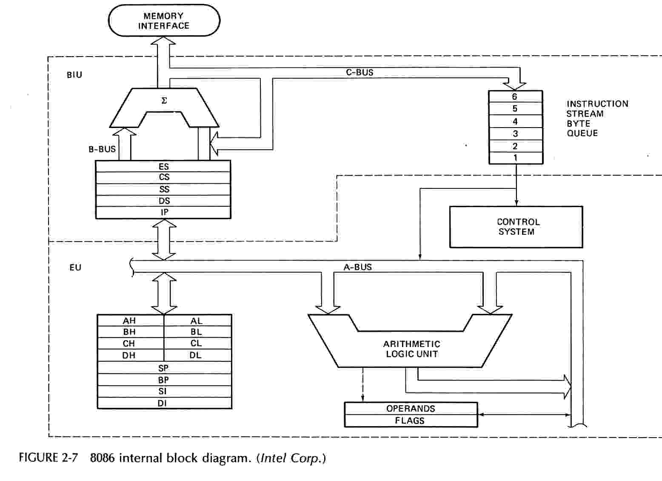
Block Diagram of Intel 8086
Control
Lines

Slide 5
Block Diagram of Intel 8086
Intel 8086 contains two independent functional units:
  Bus Interface Unit (BIU)
  Execution Unit (EU)

Slide 6
Functions of Bus Interface Unit
It handles transfer of data and addresses between the processor and memory / IO.
It fetches instruction codes.
It stores fetched instruction codes in a FIFO register called QUEUE.

Slide 7
Instruction Queue
To increase the execution speed, BIU fetches as many as six instruction bytes ahead to time from memory.
All six bytes are then held in first-in-first-out 6-byte register called instruction queue.
Then all bytes are given to EU one by one.
This pre-fetching operation of BIU may be in parallel with execution operation of EU, which improves the execution speed of the instruction.

Slide 8
Pipelining
While EU executes instructions, BIU fetches instructions from memory and stores them in the QUEUE.
BIU and EU operate in parallel independent of each other.
This type of overlapped operation of the functional units of a MP is called Pipelining.

Slide 9
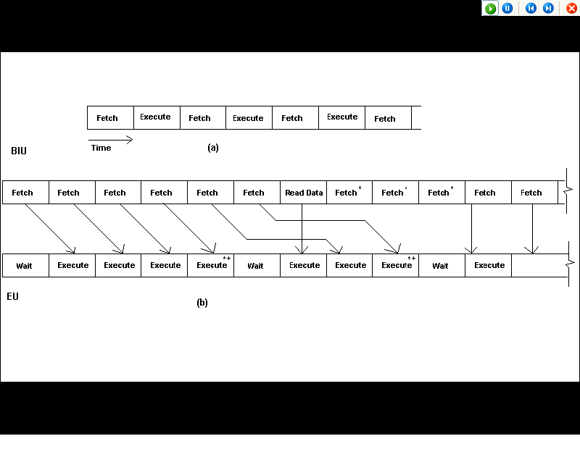

Slide 10
Functions of Execution Unit
It receives opcode of an instruction from the QUEUE.
It decodes it and then executes it.
It tells BIU where to fetch the instructions or data from.
It contains the control circuitry to perform various internal operations.

Slide 11
General Purpose Registers
There are four 16-bit general purpose registers:
  AX - AH AL ---- Accumulator – All arithmetic and logical operations
  BX - BH BL ---- Memory pointer in DS and other addressing modes
  CX- CH CL ---- Counter register in some loop instructions
  DX- DH DL ---- Used in divide and Multiplications opeartions

Slide 12
Pointer and Index Registers
Following four registers are under this category:
  Stack Pointer (SP)
  Base Pointer (BP)
  Source Index (SI)
  Destination Index (DI)

Slide 13
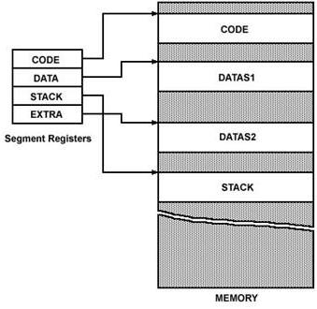
Segment Registers
There are four segment registers in Intel 8086:
  Code Segment Register (CS)
  Data Segment Register (DS)
  Stack Segment Register (SS)
  Extra Segment Register (ES)
  Each segment register is 16 bit long and has 2¹⁶ or 64KB address

Slide 14
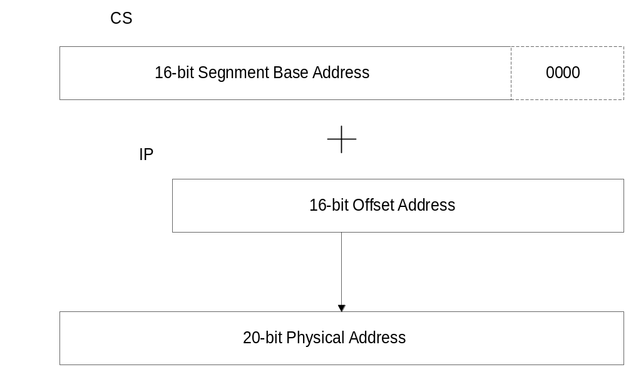
06/03/2005

Slide 15
Exercise: 20-bit Addressing
CS contains A820h,IP contains CE24h. What is the resulting physical address?
CS contains B500h, IP contains 0024h. What is the resulting physical address?
06/03/2005
ET4508_p2 (KR)

Slide 16
Status Flags
Status Flags determines the current state of the accumulator.
They are modified automatically by CPU after mathematical operations.
This allows to determine the type of the result.

Slide 17

Status Flags
8086 has 16-bit status register.
It is also called Flag Register or Program Status Word (PSW).
There are nine status flags and seven bit positions remain unused.
Flag Register of 8086

Slide 18
Status Flags
8086 has 9 flags and they are divided into two categories:
  Condition Flags: Condition flags represent result of last arithmetic or logical instruction executed
  Machine Control Flags: Control flags are set or reset deliberately to control the operations of the execution unit

Slide 19
Status Flags
Following are the nine flags:
Condition Flags | Control Flags
Carry Flag | Trap Flag
Auxiliary Carry Flag | Interrupt Flag
Zero Flag | Directional Flag
Sign Flag
Parity Flag
Overflow Flag

Slide 20
Condition Flags
Condition flags represent result of last arithmetic or logical instruction executed. Conditional flags are as follows:
Carry Flag (CF): This flag is set if there is a carry / borrow after an integer arithmetic.
Auxiliary Carry Flag (AF): If an operation performed in ALU generates a carry / borrow from lower nibble (i.e. D₀ – D₃) to upper nibble (i.e. D₄ – D₇), then AF is set. It is used in BCD Addition.
Parity Flag (PF): This flag is used to indicate the parity of result. If the result contains even number of 1’s, the Parity Flag is set and for odd number of 1’s, the Parity Flag is reset.

Slide 21
Condition Flags
Zero Flag (ZF): It is set; if the result of arithmetic or logical operation is zero else it is reset.
Sign Flag (SF): In sign magnitude format the sign of number is indicated by MSB bit. If the result of operation is negative, sign flag is set.
Overflow Flag (OF): It occurs when signed numbers are added or subtracted. An OF indicates that the result has exceeded the capacity of machine.

Slide 22
Control Flags
Control flags are set or reset deliberately to control the operations of the execution unit. Control flags are as follows:
Trap Flag (TP):
  It is used for single step control.
  It allows user to execute one instruction of a program at a time for debugging.
  When trap flag is set, program can be run in single step mode.

Slide 23
Control Flags
Interrupt Flag (IF):
  It is an interrupt enable / disable flag.
  If it is set, the INTR interrupt of 8086 is enabled and if it is reset then INTR is disabled.
  It can be set by executing instruction STI and can be cleared by executing CLI instruction.

Slide 24
Control Flags
Directional Flag (DF):
  It is used in string operation.
  If it is set, string bytes are accessed from higher memory address to lower memory address.(auto decrement mode)
  When it is reset, the string bytes are accessed from lower memory address to higher memory address.(auto increment mode)
  It is set with STD instruction and cleared with CLD instruction.

Slide 25




